Slide 1

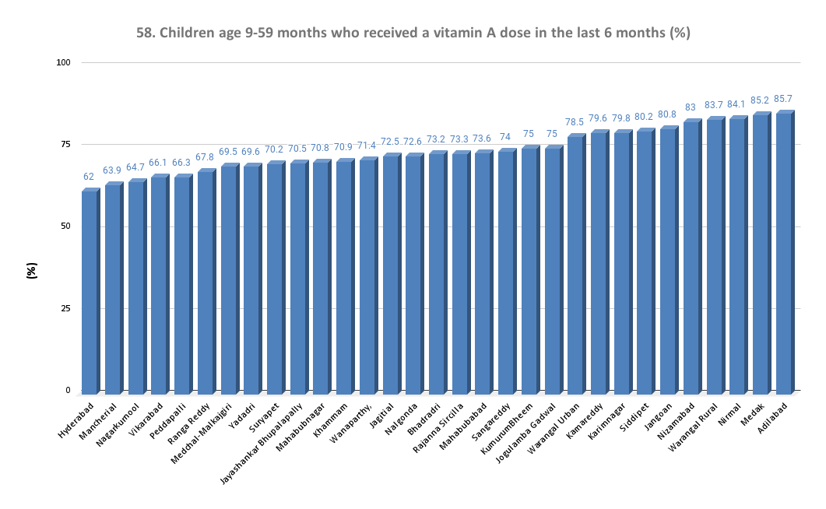
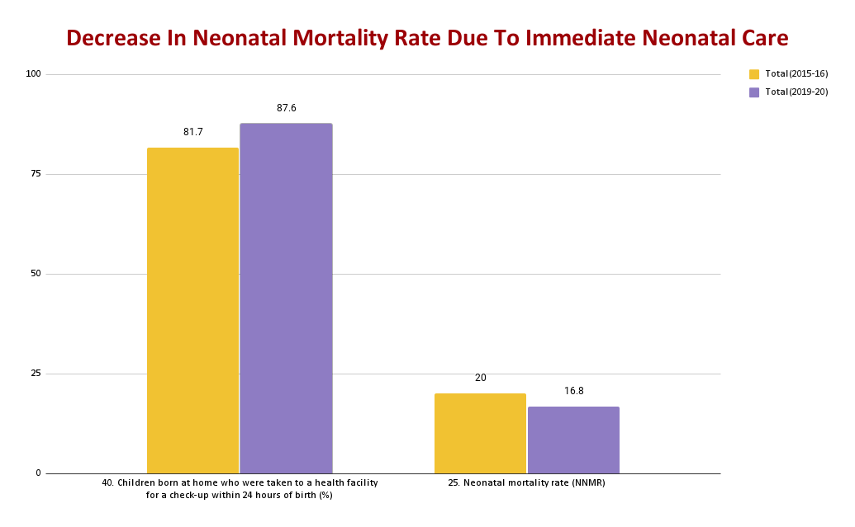
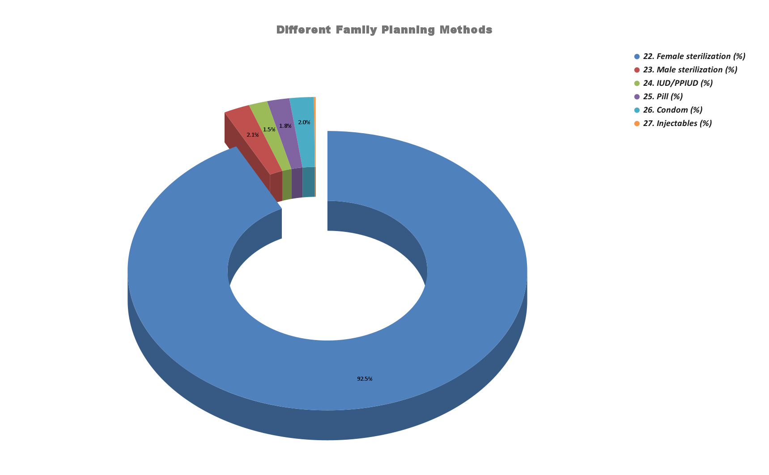
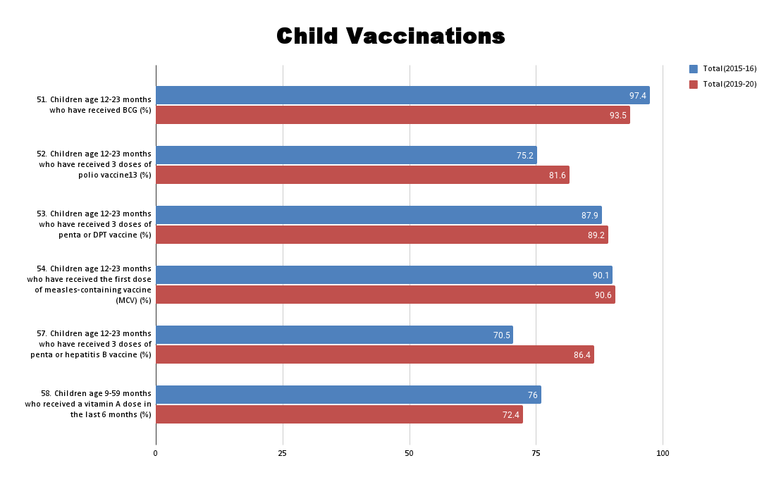
Good Health and Well Being
Completed by : Bakshi Abhinith, Kancharla Srinayan, Akash S Vora
Vasavi College of Engineering, Hyderabad
Introduction:
Ensuring healthy lives and promoting the well-being for all at all ages is essential to sustainable development. The new goal for Good Health promotes healthy lifestyles, preventive measures and modern, efficient healthcare for everyone. In this study, we examined the National Family Health Survey(NFHS-5) data and tried to give key insights on the overall health of Children and Women In Telangana.
2. This Figure shows the district wise comparision of the percentage of children receiving the Vitamin-A dose in Telangana.
4. This figure shows the relation between the neonatal mortality rate and children who received health care within 24 hours of birth.
Prompt:
Provide Key findings and insights of NFHS-5 dataset using Data Visualization( SDG-3 ).
Neonatal care plays a crucial role in preventing the death of infants immediately after birth.
From the given Figure, we can observe that the Neonatal mortality rate has decreased because the newborns were rushed to a nearby healthcare facility within 24 hours of their birth, preventing the death of the infant.
From this, we can infer that the neonatal mortality rate can further be reduced by improving the accessibility to primary healthcare facilities across the state.
Methodology:
Firstly, we have cleaned the dataset and focused on the important categories like Child Vaccinations and Vitamin A Supplementation, Current Use of Family Planning Methods,
Infant and Child Mortality Rates etc.
We have used Google sheets for visualization purposes.
Based on the above figure, more than 85% of children from Adilabad have received a dose of Vitamin-A and only about 62% of children from Hyderabad have received the same.
One factor for the above difference could be the seriousness shown by Adilabad residents regarding the ill-effects of Vitamin-A deficiency among children.
Key Findings And Insights:
Conclusion:
From the above insights, we can conclude that increasing the number of primary healthcare facilities will eventually reduce the neonatal mortality rate. In addition to this, child vaccination centres can be set up in such healthcare facilities that will reduce the prevalence of diseases that commonly occur during a child's early years. Moreover, awareness camps can be set up for consultation regarding the use of various family planning methods. Proper utilization of healthcare resources play a key role in maintaining a good standards of Health for all the residents of Telangana irrespective of their age or gender.
3.This figure shows the distribution of different family planning methods adopted in Telangana.
1. This Figure shows the change in the percentage of children receiving different types of vaccines over the years (2015-16 and 2019-20).
From the above figure, 92.5% of the families in Telangana preferred Female sterilization over any other family planning methods.
In reality, Male sterilization is far more effective and hassle free than female sterilization because it is almost painless and successfully prevents pregnancies 99.85% of the time.
Also, male sterilization has a smaller number of complications
compared to female sterilisation.
However, male sterilization is among the least used methods of family planning in Telangana.
Therefore, awareness about this topic must be spread across Telangana that highlights the pros and cons of various family planning methods.
Here, we observe that the percentage of children receiving the vaccines for Polio, Hepatitis-B, Tetanus, Measles have increased.
This could be due to the increased awareness regarding the ill-effects of these diseases, that ensured that children are given these vaccines at the right time.
However, on the contrary, we observe that the percentage of children receiving the BCG vaccine and Vitamin-A doses has decreased.
One of the reasons being the non-availability of vitamin-A supplements in Telangana.
Future directions:
This study can be extended to a broader region, generally a country's dataset to get a wider picture about the status of health across the nation.
References :
https://www.thehansindia.com/posts/index/Telangana/2019-03-08/No-vitamin-A-dosage-for-infants-in-TS/509411
https://www.healthpartners.com/blog/vasectomy-pros-and-cons/

